Slide 2

Question Marks
You will spot question marks at certain points in this Lesson Presentation.
Clicking the question marks will bring up key questions.
The assessment questions that appear will enable you to check your understanding against the lesson aim and success criteria.

Slide 3
Aim
To explore the beliefs of the ancient Greeks.
Success Criteria
I can name and describe some of the ancient Greek gods and goddesses.
I can describe some of the key beliefs of ancient Greeks and discuss how they worshipped.

Slide 4
Brainstorm
What do you know about Greek Religion.
Who did they worship?

Slide 5
Video
Whilst watching the video think about what it a similar characteristic is between all the Gods and Godesses
youtube.com/watch?v=eJCm8W5RZes&t=2s
“The Greek Gods”

Slide 6
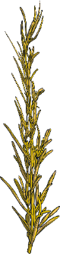







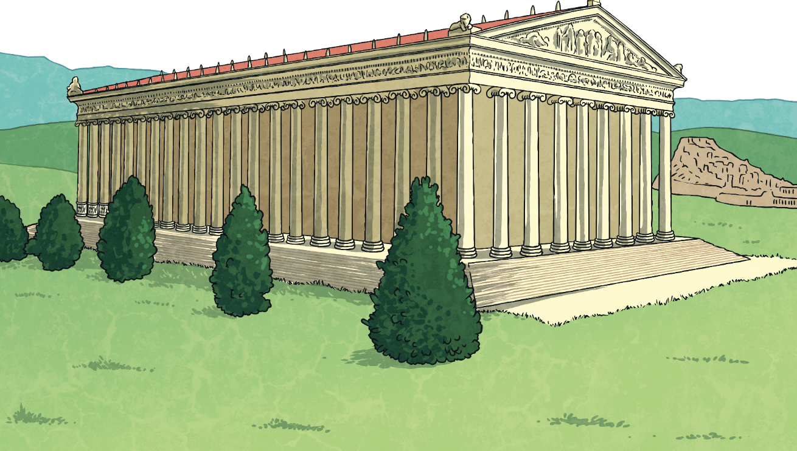
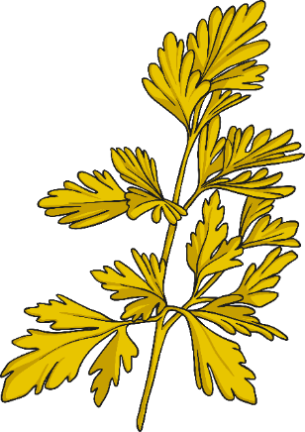
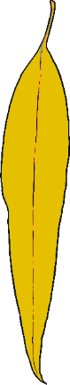
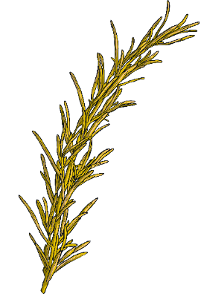
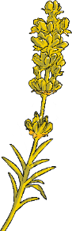
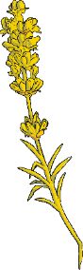
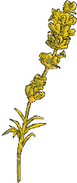
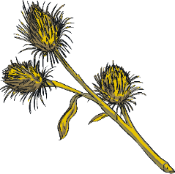
Ancient Greek Religion
Temples were built in honour of particular gods/goddesses. The ancient Greeks believed that the god/goddess, who the temple had been built for, would live in the temple or at least visit there when rituals were taking place.
Many ceremonies did not take place inside temples though. There was usually an altar outside the temple where rituals were carried out.
Religion was very important to everyone living in ancient Greek times.
The ancient Greeks believed in many different gods and goddesses. Each god/goddess represented a certain aspect of humanity.
Some gods/goddesses were patrons of cities. For example, Athena was believed to watch over the city of Athens. There was a gigantic statue of Athena in the Parthenon, the famous temple in Athens.
The ancient Greeks believed that some gods/goddesses were responsible for certain parts of life too. For example, Ares was the god of war and Hera was the goddess of family and marriage.

Slide 7
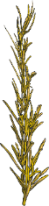
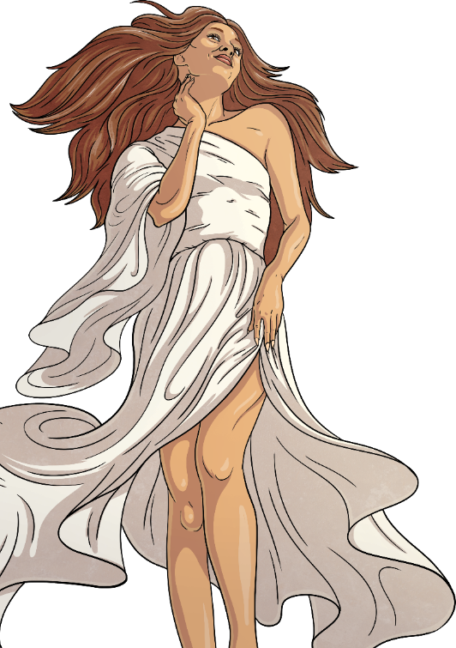

Ancient Greek Religion
Prayers would be said and drinks would be poured for the gods/goddesses.
In ancient Greek times, women had fewer freedoms than men. Being a priest was one of the few roles which allowed women to hold a position of responsibility in society. Usually, the priest at a temple would be the same sex as the god/goddess that the temple was devoted to. Priests carried out ceremonies and led rituals.
Historians have limited information about exactly what happened during rituals and ceremonies but it is understood that animal sacrifice was an important part of ancient Greek worship.
It was usually pigs, sheep, goats and cows that would be sacrificed to show the gods/goddesses how much they were respected. Usually, if the ancient Greeks were sacrificing an animal to a female goddess, they would sacrifice a female animal and male animals would be sacrificed for male gods.

Slide 8
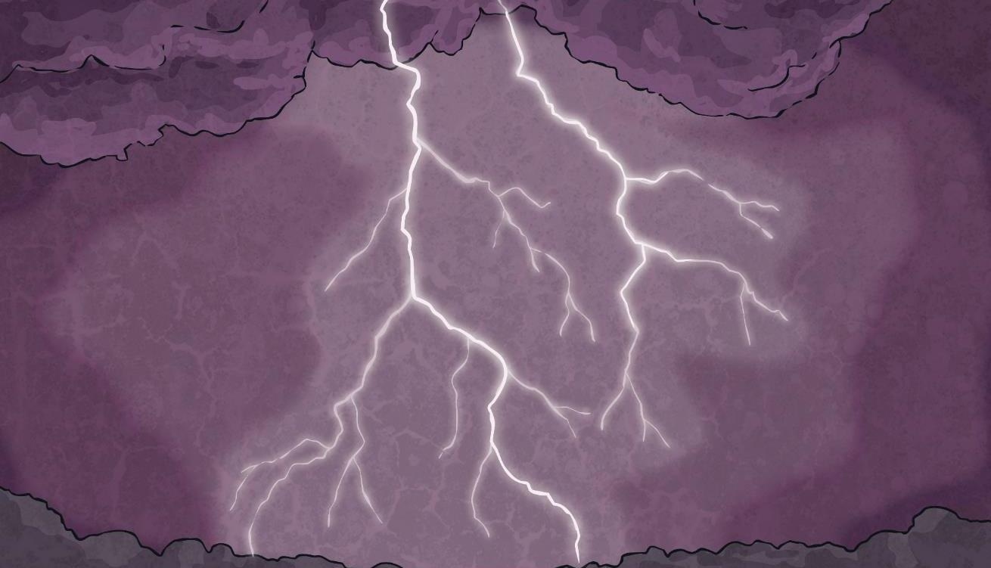
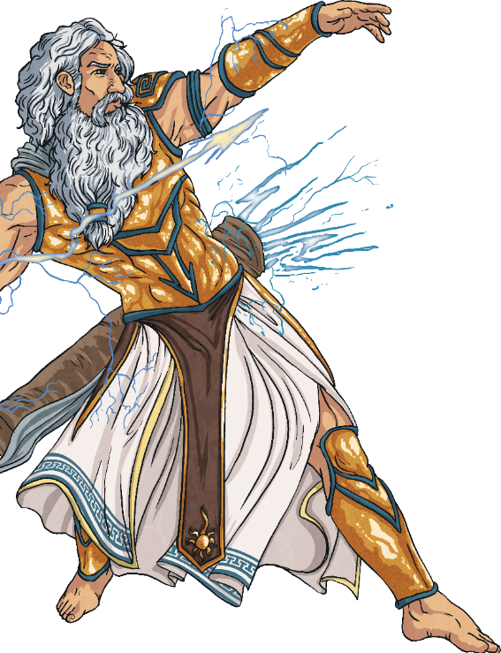
Ancient Greek Religion
When good things happened, the ancient Greeks believed that this was because the gods/goddesses were happy with the way that humans on Earth had respected them and had given them gifts.
When there were disasters, the ancient Greeks believed they had made mistakes causing the gods/goddesses to be angry.
Even though some key things were the same, what the ancient Greeks believed and how they worshipped varied in the different areas throughout Greece.

Slide 9
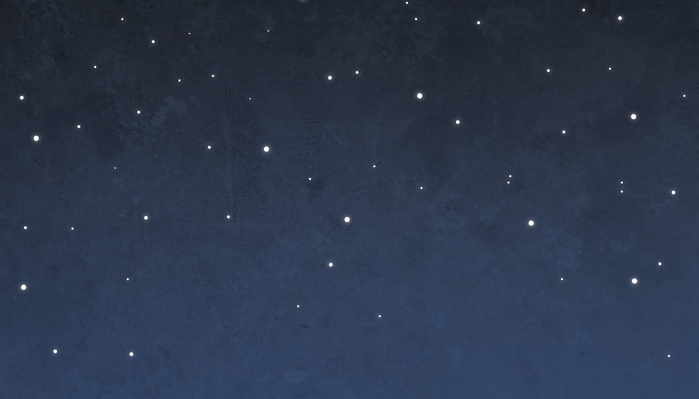
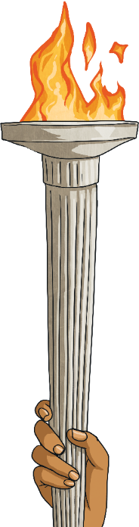

Ancient Greek Religion
Festivals were an important way that the ancient Greeks worshipped. Sometimes these festivals included musical or sporting competitions, such as the Olympic Games which was included in the Festival of Zeus.
The ancient Greeks believed that festivals, attended by people from all over Greece, were such important religious events that wars should stop for the celebrations. People travelling to and from festivals were supposed to be protected and allowed to travel safely through the entire empire, even if they were at war with other city states.
X
Write down three facts about ancient Greek beliefs and/or worship.

Slide 10
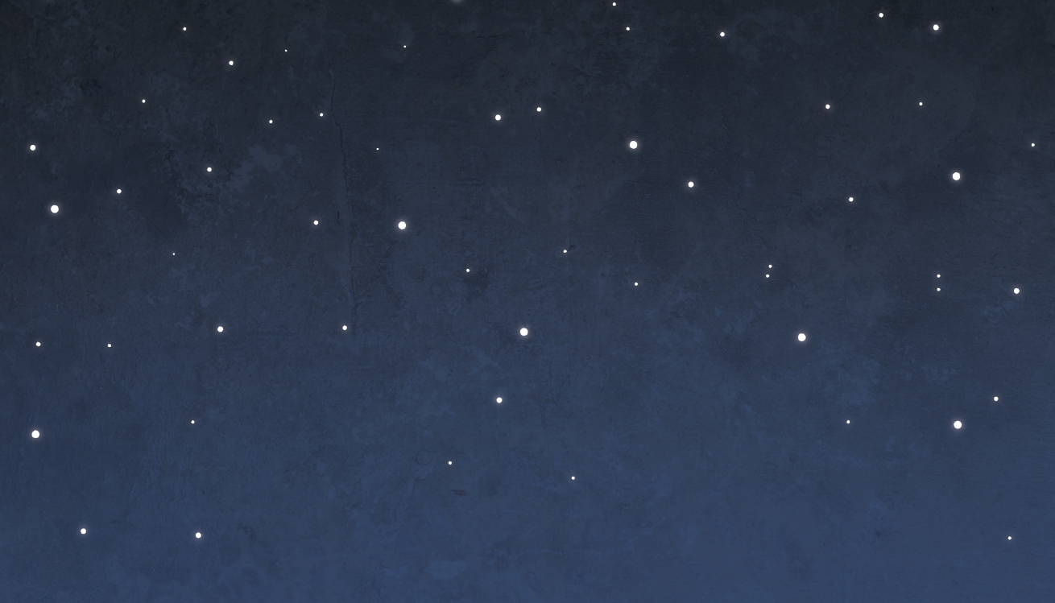
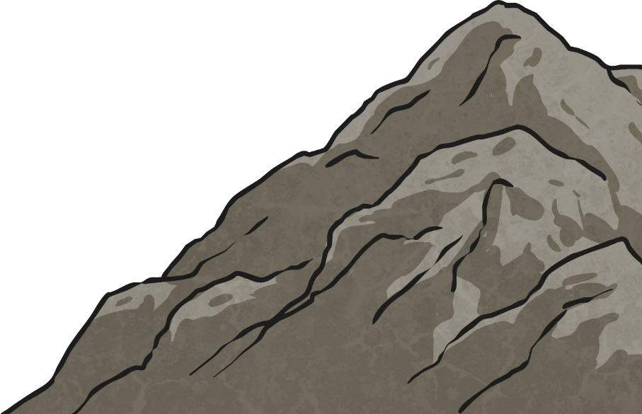
Greek Gods and Goddesses
The ancient Greeks believed that the twelve most powerful gods and goddesses lived at the top of a huge mountain called Mount Olympus. However, some very important gods/goddesses, such as Hades (god of the underworld), did not live there.
Mount Olympus was where the gods and goddesses held meetings and disputes were settled.
The ancient Greeks believed their gods/goddesses were immortal and extremely powerful but they had faults just like humans do.
Immortal: living forever.
(Immortal can be used as an adjective, e.g. He was immortal;
or as a noun, e.g. Zeus was an immortal.)

Slide 11
Greek Gods Fact Files
Over the next few slides complete the information on the Greek Gods on your fact files worksheets.

Slide 12

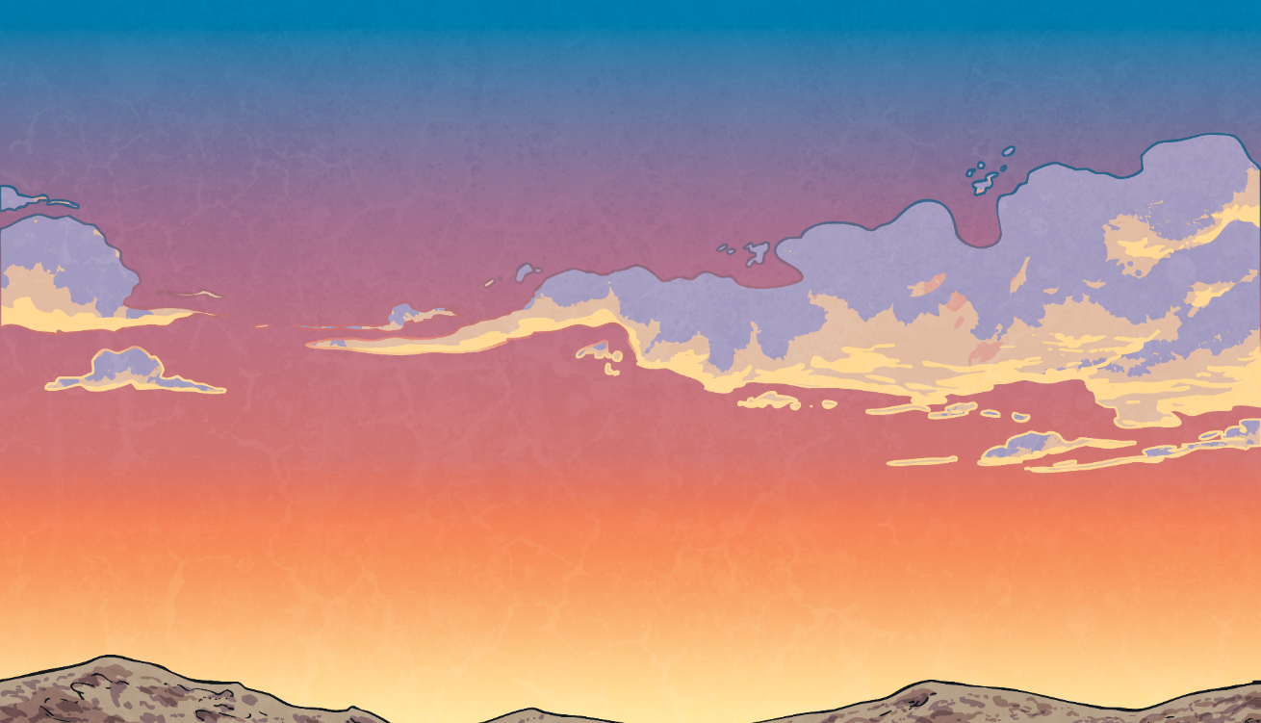
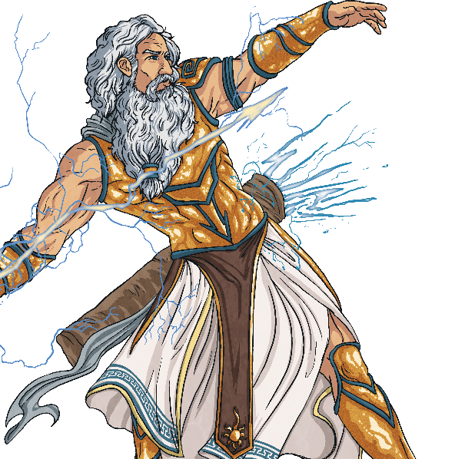
Greek Gods and Goddesses
Zeus
Zeus was the most powerful of all the gods. He was god of the sky and the king of Mount Olympus.
He was married to the queen of the gods, Hera.
His temper affected the weather, and when he was angry he threw thunderbolts.
Important symbols associated with Zeus were the thunderbolt and the eagle.
Did You Know...?
Zeus’ father was worried that his children would betray him, so he ate them! Zeus’ mother tricked his father by giving him a rock to eat so Zeus was free.

Slide 13
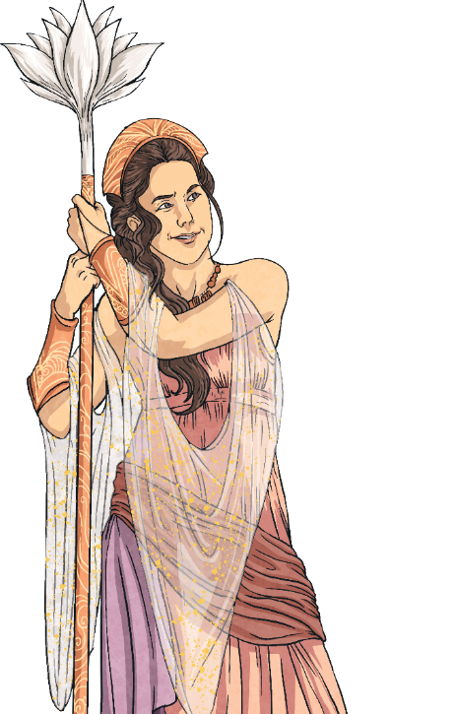
Greek Gods and Goddesses
Hera
Hera was the goddess of family and marriage.
She was the wife of Zeus.
She was powerful and beautiful but very jealous and vain.
Hera’s sacred animals were the cow, the cuckoo and the peacock.
She tried to kill Zeus’ son, Hercules.
Did You Know...?
Hera was on the side of the Greeks in the Trojan War but Zeus sided with the Trojans. She deceived and distracted her husband so that the Greeks had the upper hand during the Trojan War.

Slide 14
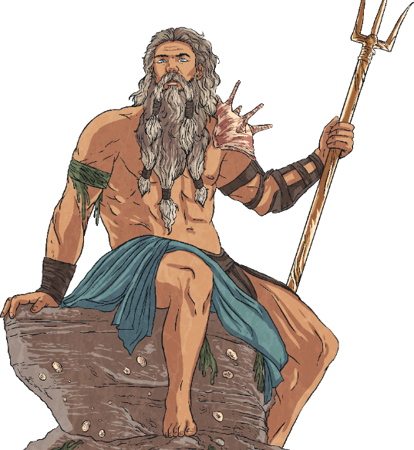
Greek Gods and Goddesses
Poseidon
Poseidon was the god of the sea. He was the most powerful god except for his brother, Zeus.
He lived in a beautiful palace under the sea and caused earthquakes when he was angry.
Sailors prayed to Poseidon that they would travel on the seas in safety.
His sacred animals were the bull, the horse and the dolphin. Poseidon was also associated with fish and any other sea animals.
Did You Know...?
Poseidon rode on a chariot pulled by fish-tailed horses.

Slide 15
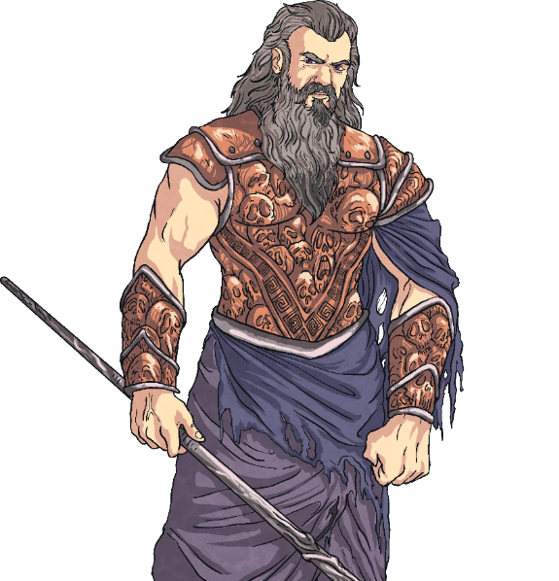
Greek Gods and Goddesses
Hades
Hades was the brother of Zeus and Poseidon.
Hades was the god of the dead. He ruled the underworld where the ancient Greeks believed people went when they died.
Ancient Greeks were terrified of him and many did not dare even say his name.
Animals associated with Hades include snakes and the screech owl.
Did You Know...?
Hades was also the god of wealth because of the precious metals that were mined from the earth.

Slide 16
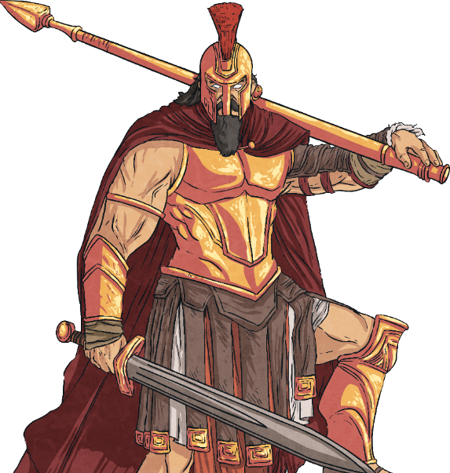
Greek Gods and Goddesses
Ares
Ares was the son of Zeus and Hera, but they did not like him.
Ares was the god of war. He represented the anger that many humans show when fighting in a battle.
He was known to complain when things didn't go his way.
He killed the giant Ekhidnades, a fierce monster and an enemy of the gods.
Did You Know...?
He was not popular with the other gods and goddesses or with the ancient Greeks and not many people worshipped him.

Slide 17
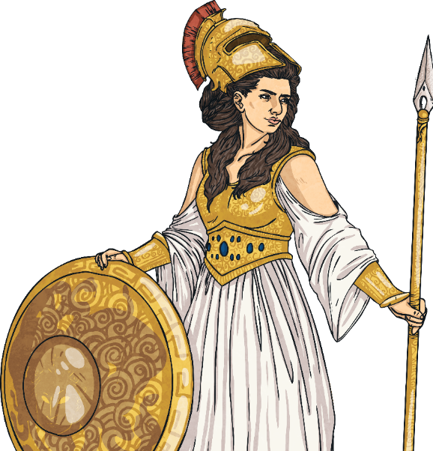
Greek Gods and Goddesses
Athena
Athena was the goddess of war, intelligence, art and literature.
Athena was the daughter of Zeus. She was born directly out of his forehead.
She was Zeus’ favourite child.
Athena turned Medusa from a human into a monster.
Athena’s symbol was an owl.
Did You Know...?
The city of Athens is named after Athena. The Parthenon is her best-known and best-preserved temple.

Slide 18
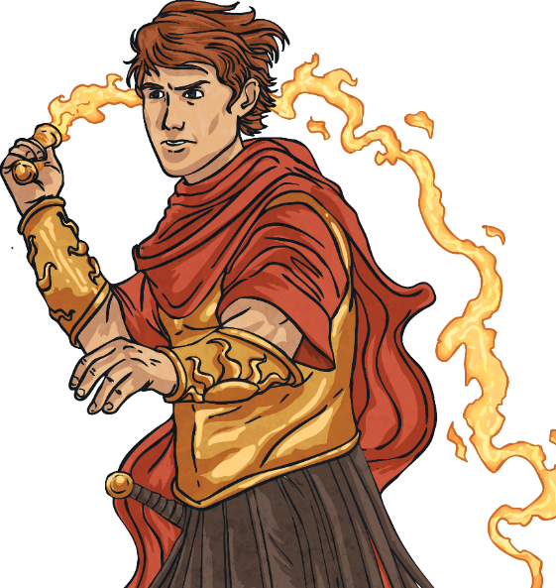
Greek Gods and Goddesses
Apollo
Apollo was the son of Zeus and the twin brother of Artemis.
Apollo was the Sun god. The ancient Greeks did not know that it is Earth that moves around the sun so they believed it was Apollo who was responsible for the movement of the Sun across the sky. They thought he moved the Sun with a chariot pulled by golden horses.
He was also the god of archery, prophecy and music.
Did You Know...?
Apollo had healing powers.

Slide 19
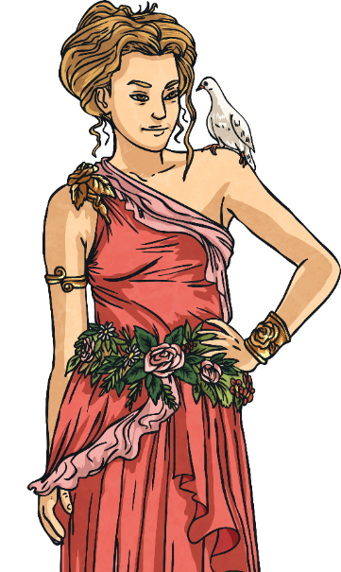
Greek Gods and Goddesses
Aphrodite
Aphrodite was the goddess of love, beauty and the protector of sailors. She was loved by many people.
She was born when Uranus was killed. Uranus’s blood fell into the sea and Aphrodite emerged from the froth.
Did You Know...?
Aphrodite changed a statue into a human so that one of her loyal followers could have the statue as his wife.

Slide 20
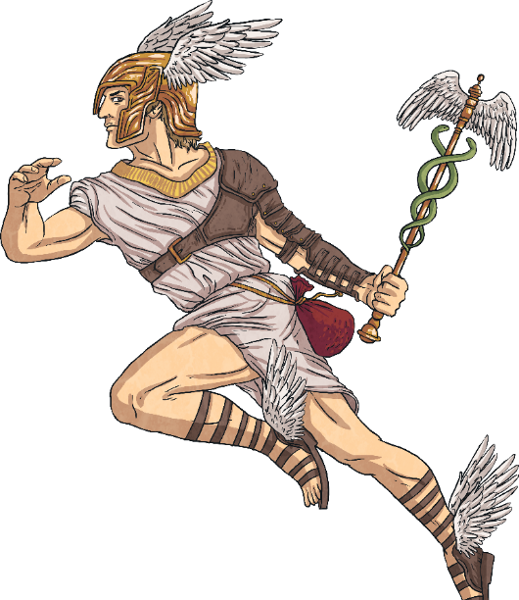
Greek Gods and Goddesses
Hermes
Hermes was Zeus’ youngest son.
Hermes was very fast on his feet and very clever so Zeus decided to make him a messenger.
Hermes always knew everything that was going on in the mythical world.
The other gods and goddesses trusted Hermes. He was very clever and loyal, and he was a good negotiator.
Animals associated with Hermes include the hawk and the tortoise.
Did You Know...?
Many ancient Greeks believed that Hermes was responsible for the invention of the alphabet, boxing and gymnastics.

Slide 21
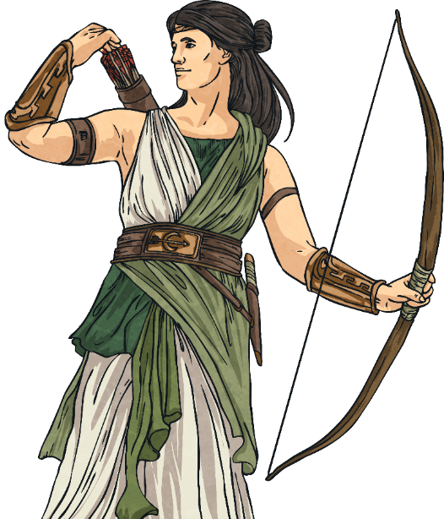
Greek Gods and Goddesses
Artemis
Artemis was the daughter of Zeus and the twin sister of Apollo.
She was a Moon goddess, responsible for the movement of the Moon across the sky at night.
The ancient Greeks believed she moved the Moon in a chariot pulled by stags.
She was also a huntress and the protector of animals and young children.
Did You Know...?
Deers and stags were associated with Artemis.

Slide 22
Aim
To explore the beliefs of the ancient Greeks.
Success Criteria
I can name and describe some of the ancient Greek gods and goddesses.
I can describe some of the key beliefs of ancient Greeks and discuss how they worshipped.
I can explore messages that ancient Greeks might have taken from some Greek myths.

